Slide 1
Artificial Intelligence
Chapter II: Problem Solving

Slide 2
Outline
Steps in Problem Solving
Defining Problems as a State Space Search
Problem Formulation
Problem Characteristics
Problem Types
  Well Defined Problems
  Constraint Satisfaction Problems
Production Systems
Game Playing

Slide 3
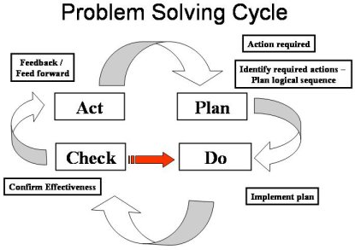

Slide 4
Steps in Problem Solving
Goal Formulation
Problem Formulation
Searching
Execution

Slide 5
2.1 Defining Problems as a State Space Search
Things that must be done to solve a problem are:
  Define the problem: It includes precise specifications of what the initial situation(s) will be as well as what final situations constitute acceptable solutions to the problem
  Analyse the problem: Few very important aspects those having immense impact on the appropriateness of various possible techniques for problem solving is to be critically examined
  Isolate and Represent the task knowledge: Knowledge necessary to solve the problem must be identified, isolated and represented
  Choose and apply the best technique: Among the alternatives identify the best technique to solve the problem and apply it

Slide 6
Defining Problems as a State Space Search
Problem Statement: Play Chess, Solve Tower of Hanoi
  To develop the solution to the problem, problem must be well identified
  Starting with specification of states, rules and outcomes
  Focusing on Solving the Problem i.e. identifying the GOAL
Incomplete and Complete Problem Statement
Complete Set of Rules is a must
  Example: If White pawn at sqr (row e, column 2) is true and White pawn at sqr (row e, column 3) is empty then Move pawn from sqr (row e, column 2) to sqr( row e, column 3) → its specific way of writing rule
  Developing such rules is very tedious as chess game alone will have 10e120
rules
  So, generalization is to be done

Slide 7
Defining Problems as a State Space Search
Problem
State
State Space: where each state corresponds to a stable situation
  Initial State
  Rules for transition from one state to another
  Final State → Ultimate Goal
State Space Representation → forms the basis for AI methods
State Space Structure corresponds to the structure of problem solving in two ways
  It allows for a formal definition of the problem
  It permits to define the process of solving the particular problem as a combination of known techniques and searching mechanism

Slide 8
Defining Problems as a State Space Search: An Example – A Water Jug Problem
Problem
You are given two jugs, a 4 litre one and a 3 litre one. None of them have any measuring markers on it. There is a pump that can be used to fill the jugs with water. How can you get exactly a 2 litres of water in to the 4 litre jug?

Slide 9
Defining Problems as a State Space Search: An Example – A Water Jug Problem
State Space
Set of ordered pair of integers (x, y), such that x= 0, 1, 2, 3, or 4 and y= 0, 1, 2, or 3, where x represents the quantity of water in 4 litre jug and y represents the quantity of water in 3 litre jug
The start state is (0, 0)
The final state is (2, n)

Slide 10
Defining Problems as a State Space Search: An Example – A Water Jug Problem → Rules
1. (x, y) if x<4 → (4, y) Fill the 4 litre jug
2. (x, y) if y<3 → (x, 3) Fill the 3 litre jug
3. (x, y) if y>0 → (x, 0) Empty the 3 litre jug
4. (x, y) if x>0 → (0, y) Empty the 4 litre jug
5. (x, y) if x>o → (x-d, y)
Put some water out of 4 l jug
6. (x, y) if y>0 → (x, y-d)
Put some water out of 3 l jug
7. (x, y) if x+y>=4 & y>0 →(4, y-(4-x))
Put water from 3l jug into 4l jug to fill it
8. (x, y) if x+y>=3 & x>0 →(x-(3-y), 3)
Put water from 4l jug into 3l jug to fill it
9. (x, y) if x+y<3 & x>0 →(0, x+y)
Put all the water from 4l jug in to 3l jug
10. (x, y) if x+y<4 & y>0 →(x+y, 0)
Put all the water from 3l jug in to 4l jug

Slide 11
Defining Problems as a State Space Search:
An Example – A Water Jug Problem → Solution
Water Quantity in 4 l Jug | Water Quantity in 3 l Jug | Rule Applied
0 | 0 | 2
0 | 3 | 10
3 | 0 | 2
3 | 3 | 7
4 | 2 | 4
0 | 2 | 10
2 | 0

Slide 12
Defining Problems as a State Space Search
Operationalization
  Its the process of creation of a formal and manipulability description of the problem
  It is the first step toward the design of a program to solve a problem
  We expect to create such programs which can themselves produce formal descriptions of the problems from the informal ones

Slide 13
2.2 Problem Formulation
→Process of deciding what action and states to consider, given a goal.
For providing a formal description of a problem, the things to be done are:
Define a state space that contains all the possible configuration of the relevant objects.
Specify one or more states within the space that describe possible situations from which the problem-solving process may start, known as the initial states.
Specify one or more states that would be acceptable as solutions to the problem, known as the goal states or final states.
Specify a set of rules that describe the actions (operators) available. While doing these, the following issues are to be highlighted:
  What unstated assumptions are present in the informal problem description?
  How much the rules should be generalized?
  How much of the work required solving the problem should be pre- computed and represented in the rules.

Slide 14
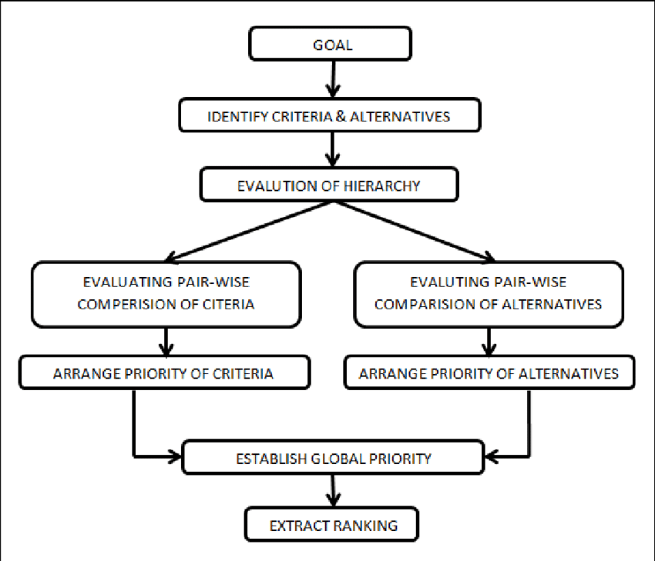
The five problem characteristics were: (1) problem clarity, (2) problem familiarity, (3) the extent to which the problem stimulated group discussion, (4) self-study, and (5) identification of learning goals

Slide 15
Problem Characteristics
What is the possibility in terms of decomposability( To Decay)?
Can solution be ignored or undone?
What about predictability of universe?
Is it absolute or relative solution?
Is the solution a path or a state?
What is the role of knowledge?
Does the task require interaction with a person?
Can problem be classified?

Slide 16
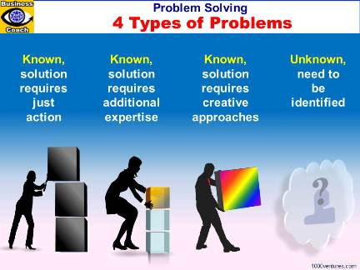
2.3. Problem Types
Well Defined Problems
Constraint Satisfaction Problems

Slide 17
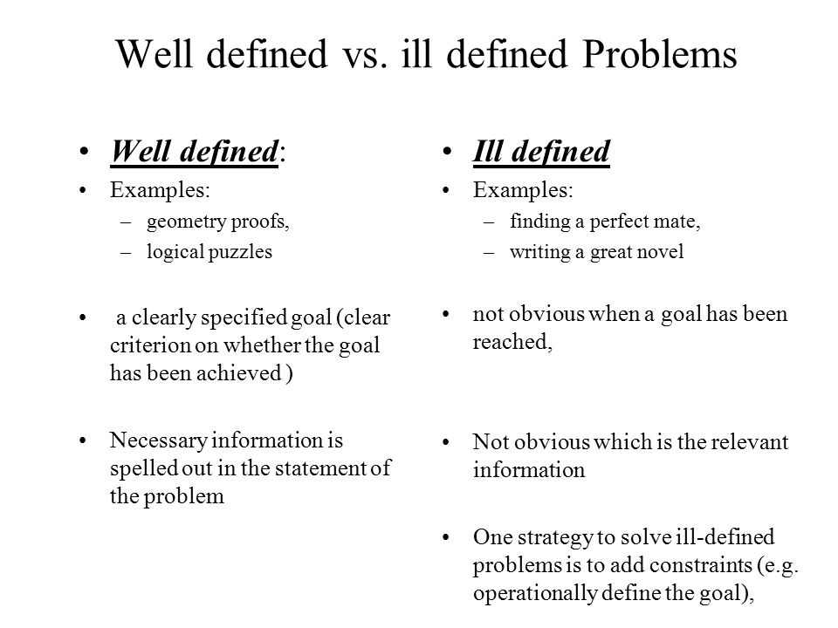

Slide 18
Problem Types: Well Defined Problem
Major Components of a Problem
  Initial State
  Actions available to the agent in the state space
  Goal Test determining the given state as a goal state
  Path Cost function that assigns numeric value to each path considering the
step cost as well
If all these components are completely defined along with the optimal solution for the problem, then such problem is a well defined problem

Slide 19
Problem Types: Well Defined Problem
Generalization of actions and rules
Specialization of actions and rules

Slide 20
Problem Types: Constraint Satisfaction Problem
For example, in a crossword puzzle it is only required that words that cross each other have the same letter in the location where they cross.
A search procedure that operates in a space of constraint sets
Constraints are discovered and propagated as far as possible through out the system
It (Search) continues until the solution is achieved
An assumption is made about something and added as a new constraint

Slide 21
Problem Types: Constraint Satisfaction Problem
Constraint Satisfaction Problem consists of variables with constraints on them
Many important real world problems can be described as CSPs
The structure of a CSP can be represented by constraint graph
CSP has states and goal test conformed to a standard, structured and very simple representation
Simply, CSP is such that the goal is to discover some problem state that satisfies a given set of constraints

Slide 22
Problem Types: Constraint Satisfaction Problem
A CSP is defined by a set of variables, X1, X2, …, Xn, and a set of constraints, C1, C2, …, Cm. Each variable Xi has a non empty domain Di of possible values. Each constraint Ci involves some subset of the variables and specifies the allowable combinations of values for that subset. A state of the problem is defined by an assignment of values to some or all of the variables, {Xi=Vi, Xj=Vj,…}.

Slide 23
Problem Types: Constraint Satisfaction Problem
Constraint propagation terminates for one of the two reasons:
  Contradiction detected: No solution consistent with known constraints
  Propagation has run of stream and there are no further changes that can be made on the basis of current knowledge
Variables:
Constraints:
Discrete and Finite Domain Linear and Non Linear

Slide 24
Problem Types: Constraint Satisfaction Problem
Types of Constraints
  Unary:
  Binary:
  Higher order constraints:
Restricts the value of single variable Two variables
More than two variables

Slide 25
Definition: Constraint Satisfaction Problem
Consider a Sudoku game with some numbers filled initially in some squares.
You are expected to fill the empty squares with numbers ranging from 1 to 9 in such a way that no row, column or a block has a number repeating itself.
This is a very basic constraint satisfaction problem.
You are supposed to solve a problem keeping in mind some constraints.
The remaining squares that are to be filled are known as variables, and the range of numbers (1-9) that can fill them is known as a domain.
Variables take on values from the domain. The conditions governing how a variable will choose its domain are known as constraints.

Slide 26
A constraint satisfaction problem (CSP) is a problem that requires its solution within some limitations or conditions also known as constraints.
It consists of the following:
A finite set of variables which stores the solution (V = {V1, V2, V3,....., Vn})
A set of discrete values known as domain from which the solution is picked (D = {D1, D2, D3,.....,Dn})
A finite set of constraints (C = {C1, C2, C3,......, Cn})

Slide 27
Popular Problems with CSP
The following problems are some of the popular problems that can be solved using CSP:
Crypt Arithmetic (Coding alphabets to numbers.)
n-Queen (In an n-queen problem, n queens should be placed in an nXn matrix such that no queen shares the same row, column or diagonal)
Map Coloring (coloring different regions of map, ensuring no adjacent regions have the same color)
Crossword (everyday puzzles appearing in newspapers)
Sudoku (a number grid)

Slide 28
Game Playing
Multi agent environments
Games and adversarial search
Game theory: a branch of economics that views any multi agent environment as a game provided that the impact of each agent on the others is significant, regardless of whether the agents are cooperative and competitive

Slide 29


Slide 30
Game Playing is an important domain of artificial intelligence.
Games don’t require much knowledge; the only knowledge we need to provide is the rules, legal moves and the conditions of winning or losing the game.
Both players try to win the game.
So, both of them try to make the best move possible at each turn. Searching techniques like BFS(Breadth First Search) are not accurate for this as the branching factor is very high, so searching will take a lot of time.
So, we need another search procedures that improve –
Generate procedure so that only good moves are generated.
Test procedure so that the best move can be explored first.
The most common search technique in game playing is Minimax search procedure. It is depth-first depth-limited search procedure.
It is used for games like chess and tic-tac-toe.

Slide 31
Minimax algorithm uses two functions –
MOVEGEN : It generates all the possible moves that can be generated from the current position.
STATICEVALUATION : It returns a value depending upon the goodness from the viewpoint of two-player

Slide 32
Production System
A production system in AI is a type of computer program that provides artificial intelligence based on a set of rules.
A production system (popularly known as a production rule system) is a kind of cognitive architecture that is used to implement search algorithms and replicate human problem-solving skills.
This problem-solving knowledge is encoded in the system in the form of little quanta popularly known as productions.
It consists of two components: rule and action.
Example: Water Jug Problem

Slide 33
Rules recognize the condition, and the actions part has the knowledge of how to deal with the condition.
In simpler words, the production system in AI contains a set of rules which are defined by the left side and right side of the system.
The left side contains a set of things to watch for (condition), and the right side contains the things to do (action).

Slide 34
What are the Elements of a Production System?
An AI production system has three main elements which are as follows:
Global Database: The primary database which contains all the information necessary to successfully complete a task. It is further broken down into two parts: temporary and permanent. The temporary part contains information relevant to the current situation only whereas the permanent part contains information about the fixed actions.
A set of Production Rules: A set of rules that operates on the global database. Each rule consists of a precondition and postcondition that the global database either meets or not. For example, if a condition is met by the global database, then the production rule is applied successfully.
Control System: A control system that acts as the decision-maker, decides which production rule should be applied. The Control system stops computation or processing when a termination condition is met on the database.

Slide 35
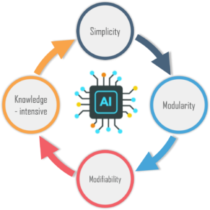

Slide 36
What are the Features of a Production System?
A production system has the following features:
1. Simplicity: Due to the use of the IF-THEN structure, each sentence is unique in the production system. This uniqueness makes the knowledge representation simple to enhance the readability of the production rules.
2. Modularity: The knowledge available is coded in discrete pieces by the production system, which makes it easy to add, modify, or delete the information without any side effects.
3. Modifiability: This feature allows for the modification of the production rules. The rules are first defined in the skeletal form and then modified to suit an application.
4. Knowledge-intensive: As the name suggests, the system only stores knowledge. All the rules are written in the English language. This type of representation solves the semantics problem.

Slide 37
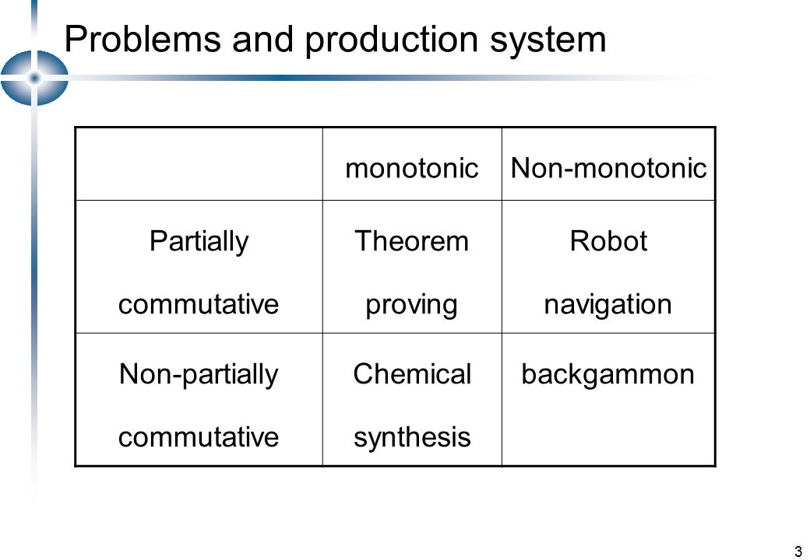

Slide 38
Monotonic Production System: In a monotonic production system, the use of one rule never prevents the involvement of another rule when both the rules are selected at the same time. Hence, it enables the system to apply rules simultaneously.
Partially Commutative Production System: In this production system if a set of rules is used to change state A to state B then any allowable combination of these rules will also produce the same results (convert state A to state B).
Non-Monotonic Production System: This production system increases the problem-solving efficiency of the machine by not keeping a record of the changes made in the previous search process. These types of production systems are useful from an implementation point of view as they do not backtrack to the previous state when it is found that an incorrect path was followed.
Commutative Production System: These type of production systems is used when the order of operation is not important, and the changes are reversible.

